Slide 1


Sketch-level T&R Study for Hood River Bridge Hood River, Oregon
February 19, 2019

Slide 2
Agenda
Hood River Bridge T&R Analysis
Scope
Modeling Approach
Data Collection
Spreadsheet Model
T&R Forecasts
Questions
T&R 101
Levels of T&R Studies
Bond Financing
Parties Involved in Bond Sale

Slide 3
1. What are the different levels of T&R studies?

Slide 4
Sketch Level Study
  Levels of Study
    Sketch
    Level I
    Level II
    Level III – “Investment Grade”
  Often referred to as “back-of-the-envelope” analysis
  Performed at a very high level
  Generally utilizes already available data
  Used only as a guidance to assess need for more detailed studies
  Followed by policy-specific analysis sensitive to
    Toll-rates
    Shares of electronic payment and cash/video customers
    Costs associated with AET

Slide 5
Level 1 Study
  Slightly more detailed analysis than sketch-level analysis
  Helps assess project-viability early on
  Generally performed for newly proposed toll facilities
  Involves site reconnaissance and some additional data-gathering
  Final output: a short report or technical memorandum summarizing the findings

Slide 6
Level 2 Study – Can be Used for Financing
  Usually conducted when a Level 1 study deems a toll-project viable
  Involves more extensive site-visits, data-collection efforts, and use of a travel model
  Supported by a team of sub-consultants and/or local sub-contractors
  Final output: a detailed report on the assumptions and findings of the study, including sensitivity analyses to build a range of traffic and revenue forecasts reflecting the impact of changes in tolling assumptions
  In some situations, Level 2 reports can be taken to financing

Slide 7
Level 3 – Often Called Investment Grade Study
  Most comprehensive traffic and revenue study
  Typically involves large amounts of data collection, development of a forecasting model and extensive analysis of economic factors not considered in other levels of study
  Often confused with “Investment Grade Rating”
  Investment grade study does not guarantee investment grade rating of bonds
  T&R forecast is only one of the several factors considered by a rating agency
  Personally prefer comprehensive study because it defines level of effort

Slide 8
2. What are the pieces that go into a bond sale?

Slide 9
Pieces of a Municipal Bond Sale
Independent Registered Municipal Advisors
Financial Plan
Preliminary Official Statement (POS)
Official Statement (OS)
PUBLIC AGENCY
Business Policy, Capital Plan, Toll Structure, Management, etc.
Feasibility Consultants
Revenue Forecast, Operating Expenses,
Reports
Purpose of Bond Sales:
Typically used to raise capital for highway and bridge projects
May be used to refinance old debt to lower cost of borrowing
May be used for other purposes using revenues from toll authority
  Mass transit in NYC; Off Turnpike projects in Ohio, etc.

Slide 10
Pieces of a Municipal Bond Sale
Project Goals – Capital Plan
Toll Policy and Business Rules
Toll Traffic and Gross Revenues
Fee Revenues
Operating Expenses
Finance Plan
Management
Legislative / Legal Authority
For the rating agencies,
it is all about
correctly accounting
for the RISK.

Slide 11
Ratings
Multi – asset
Legacy
Well Managed
Greenfield
Concession
High Risk

Slide 12
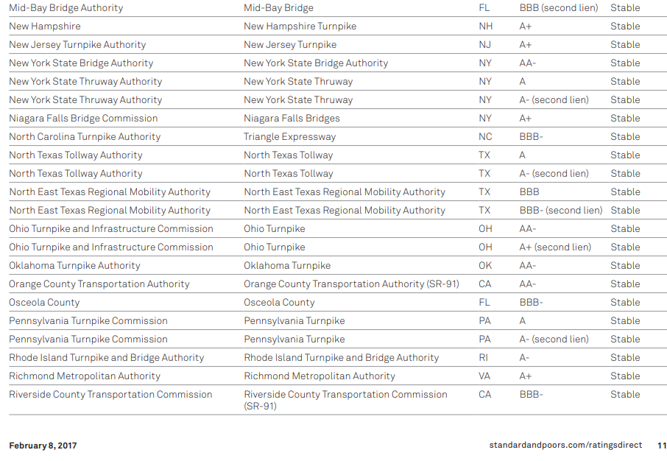
Ratings – S&P’s

Slide 13
Simple Toll Revenue Financing
Capital Cost Considerations (Why Borrowing)
Cost of Bridge
Cost of Back Office
Revenue Considerations
Toll Rates
Fees and Fines
Operating Cost Considerations
Cost of Maintaining Roadway
Cost of Maintaining Toll Equipment
Cost of Toll Collection
Concession & Other Revenues
Cost to Collect Tolls

Slide 14
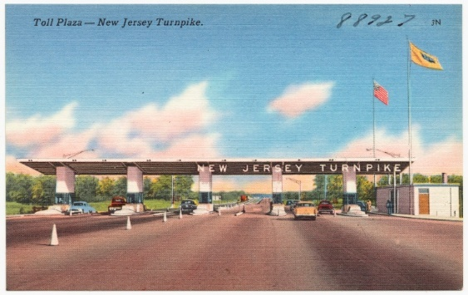
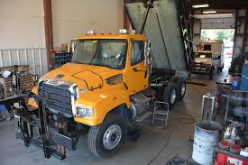
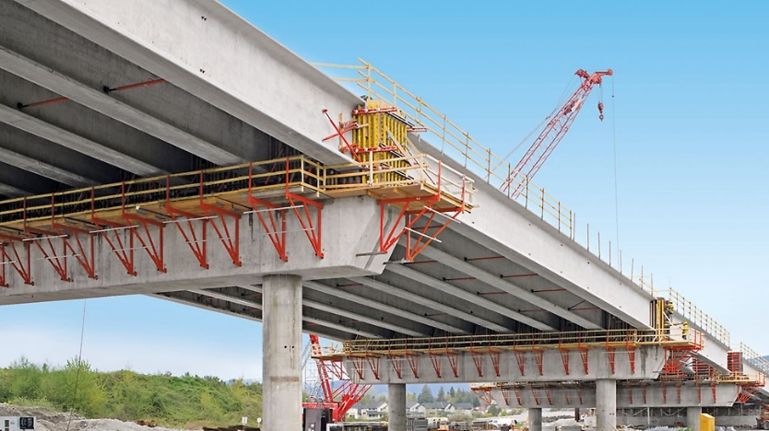
Simple Toll Revenue Financing
Capital Cost
Construction of New Roadway
Structures and Support Buildings
Equipment
Computers, Collection Equipment and Software
In some cases transponders

Slide 15
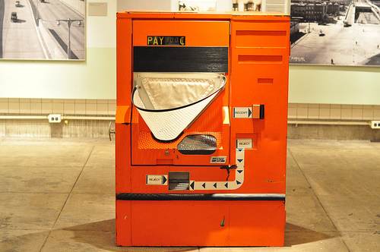
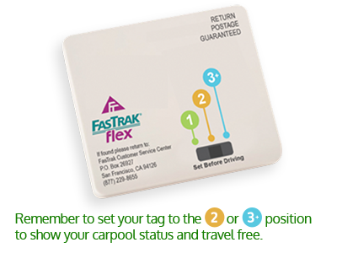
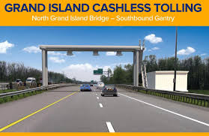
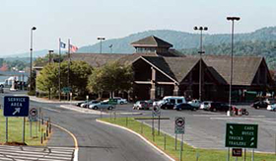
Simple Toll Revenue Financing
Revenue
Total Revenues
    Cash Coins
    Transponder
    Video Toll
Other Revenues
    Concessions
    Fees / Fines
    Interest on Deposit
    Other revenue-generating activities

Slide 16
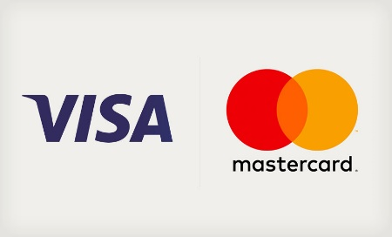
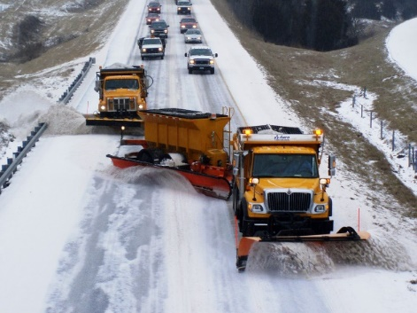
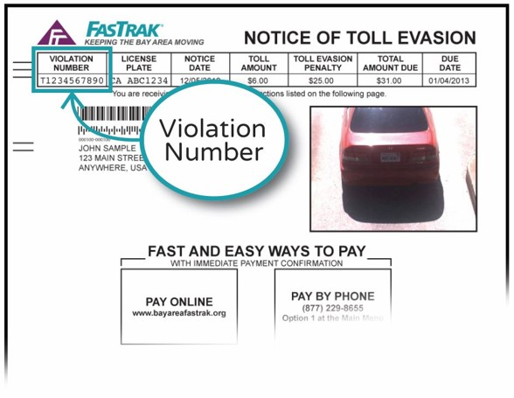
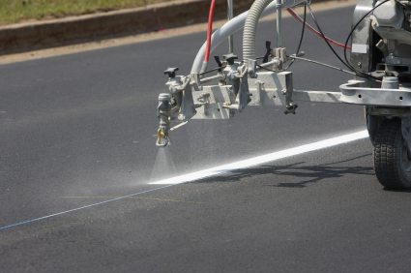

Simple Toll Revenue Financing
Operating Costs
Roadway O&M
  Plowing
  Painting / maintenance
  Repairs
Back Office
  Call-center
  Mailings
  Credit card fees
Staff
  Administrative
  Police
  Utilities
  Benefits
  Insurance

Slide 17
Simple Toll Revenue Financing
Debt Service
Payments towards funds that were obtained through a bond sale Combination of interest and principal
Interest
  Agreed to rate that money is borrowed at
Principal
  Payments against the actual money borrowed
Tax Status
  Tax-free and taxable bonds
Senior and junior Bonds
Debt Service Coverage
Similar to Mortgage
Operating Costs - Must have money to maintain the facility
Net Revenue - Must have money in excess of debt service payments after maintaining the facility
Coverage – Monies remaining after paying for maintenance
Debt Service Coverage Ratio – Net Revenue divided by Debt Service

Slide 18
Simple Calculation
Total Revenue
Tolls, Fees, Fines | $5,000,000
Less operating costs
Bridge, collection, back-office | $3,800,000
Equals
Net revenue | $1,200,000
Debt Service | $1,000,000
Net Revenue divided by Debt Service
Coverage ratio | 1.2

Slide 19
Coverage Calculator

Slide 20
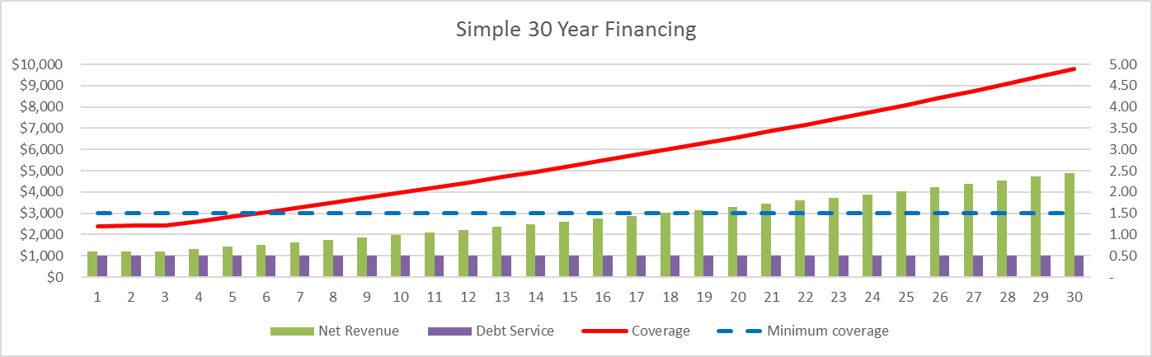
Coverage Analysis - 30 years
Trust Agreement Requires 1.5 Debt Service Coverage Ratio

Slide 21
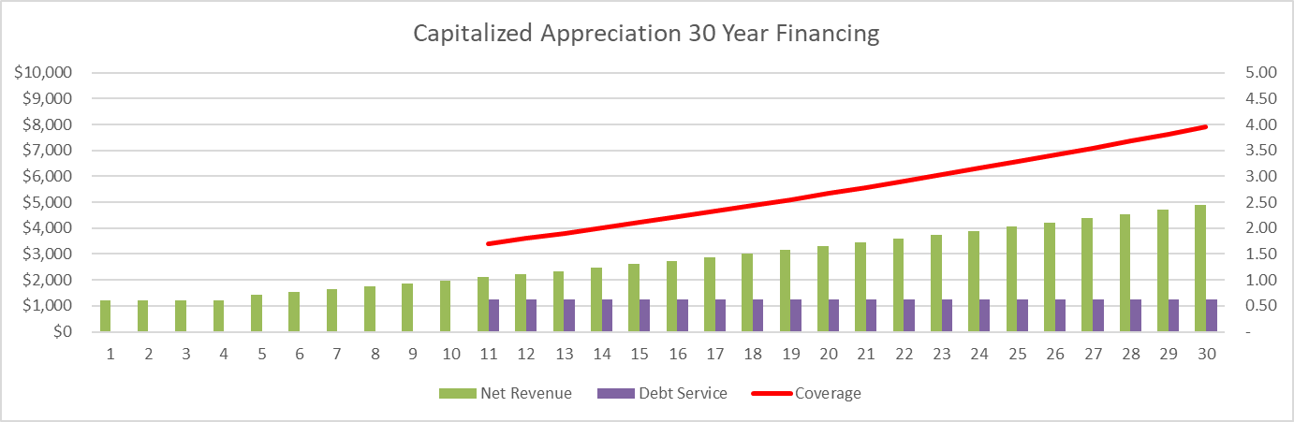
Coverage Analysis - 30 years
Trust Agreement Requires 1.5 Debt Service Coverage Ratio

Slide 22
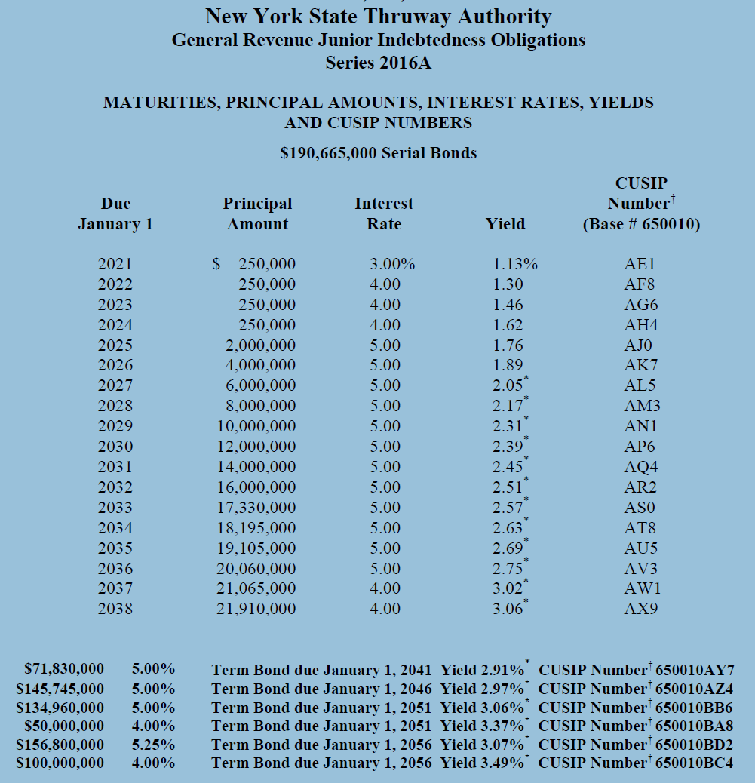
Actual Bonds from Recent Bond Sale
From actual bond
Series of bonds
All designed to meet the needs of the capital projects
Toll policy
The market place for the bonds
And the Debt Service Coverage Ratio

Slide 23
3. Who are the parties involved in a municipal bond sale?

Slide 24
Among the Parties to A Municipal Bond Sale
Bond Counsel
Municipal Advisors
PUBLIC AGENCY
The Deal “Table”
Feasibility Consultants
Rating Agency
Underwriter(s)
Trustee
Credit Enhancer Insurer
Underwriter’s Counsel
Disclosure Counsel
Investors
Other Counsel

Slide 25
Among the Parties To A Bond Sale
Public Agency
  Borrower
Municipal Advisor
  Advises agency on how to borrow
Bond Counsel
  Prepares POS/OS, legal issues
Feasibility Consultants
  T&R, O&M, Condition of Facilities
Rating Agencies
  Assess everyone’s credibility
Credit Enhancers
  Insure bonds to lower interest rate
Underwriter
  Buys bond from agency & sells to investors
Trustee
  Protects bond holders and makes sure agency keeps promises
Disclosure Counsel
  Assure that all material information is disclosed to investors
Investors
  Buy bonds from Underwriter
Other Counsels
  As needed cashing in on deal ☺

Slide 26
Municipal Bond Sale Timeline
PUBLIC AGENCY
Capital Plan
Financial Plan
Toll Modification
Updated Plan
Feasibility Consultants
T&R and
O&M Forecast
Financial Advisor
PUBLIC AGENCY
Financial Advisor
Feasibility Consultants
Underwriter(s)
Bond Counsel

Slide 27
Municipal Bond Sale Timeline
RATINGS
DRAFT POS (Preliminary Official Statement)
Due Diligence
ISSUE POS
PUBLIC AGENCY
PUBLIC AGENCY
Financial Advisor
PUBLIC AGENCY
Financial Advisor
PUBLIC AGENCY
Feasibility Consultants
Feasibility Consultants
Disclosure Counsel
Feasibility Consultants
Disclosure Counsel
Bond Counsel
Bond Counsel
Bond Counsel
Other Counsel
Bond Counsel
Other Counsel
Underwriter(s)
Rating Agency
Underwriter(s)
Underwriter(s)
Feasibility Consultants
Financial Advisor
Underwriter’s Counsel
Underwriter’s Counsel
Underwriter(s)

Slide 28
Municipal Bond Sale Timeline
INVESTOR ROAD SHOW
PRICING
ISSUE OS (Official Statement)
AGENCY GETS MONEY
UNDERWRITER(S) SELLS BONDS
PUBLIC AGENCY
PUBLIC AGENCY
SEE POS LIST
PUBLIC AGENCY
Underwriter(s)
Underwriter(s)
Underwriter(s)
Underwriter(s)
Investor(s)
Feasibility Consultants
Financial Advisor
Bond Counsel
Financial Advisor
Investor(s)
Financial Advisor
Investor(s)

Slide 29
Suggested Timeline for Hood River T&R Studies
Sketch Level
Level 2 Study
Investment Grade (Refreshed Level 2)
Toll Policy Development
2 months
Soon in 2019
$200k-$300k
3 qtr 2020
6-9 months
$100K-$150k
3 qtr 2022
3-6 months
$20k
$50k to $60k
Completed

Slide 30
Hood River Bridge T&R Study

Slide 31
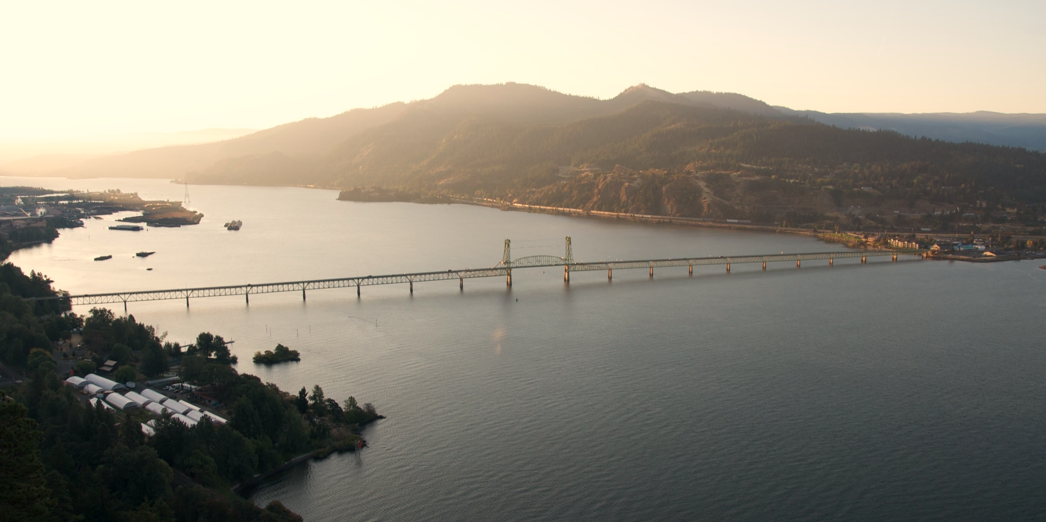
Scope
Sketch-level study
Traffic and revenue estimate for two cases:
  Existing bridge conditions
  New bridge conditions with AET
Include toll O&M cost estimate
Scope
Sketch-level study
Traffic and revenue estimate for two cases:
  Existing bridge conditions
  New bridge conditions with AET
Includes toll O&M cost estimate

Slide 32
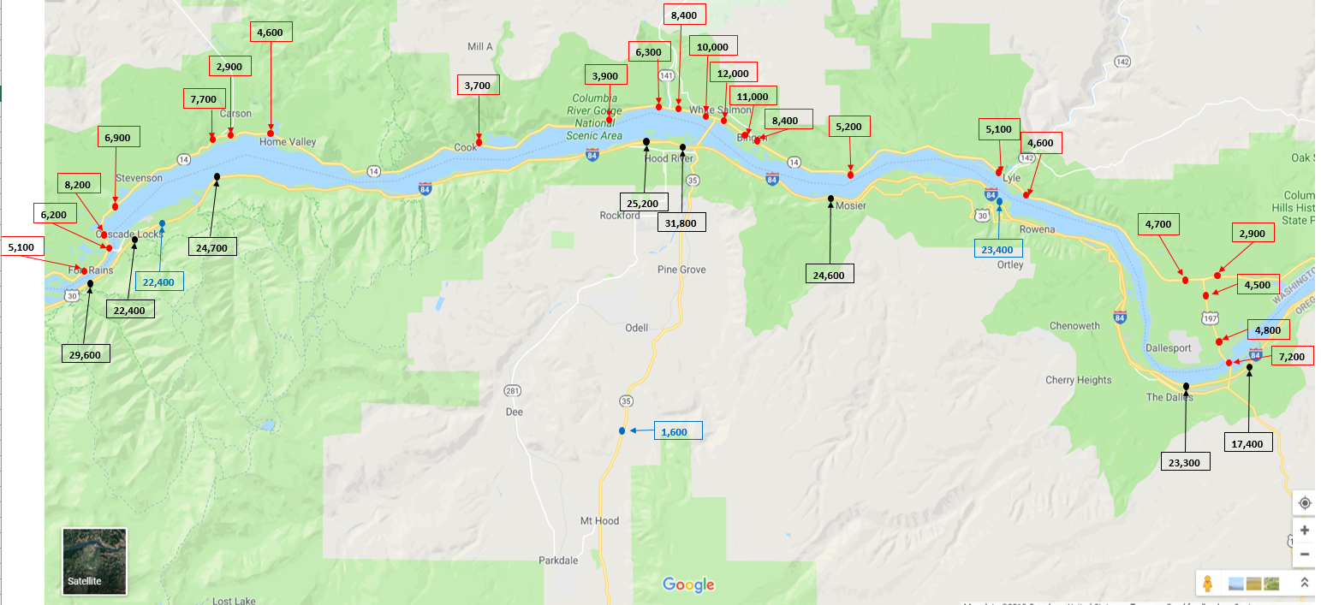
Data Collection
AADT data from Oregon and Washington DOTs
Collected data along the river, between the competing bridges
Field spot-surveys to observe truck activity at key locations
Hood River Bridge
Bridge of the Gods
The Dalles Bridge

Slide 33
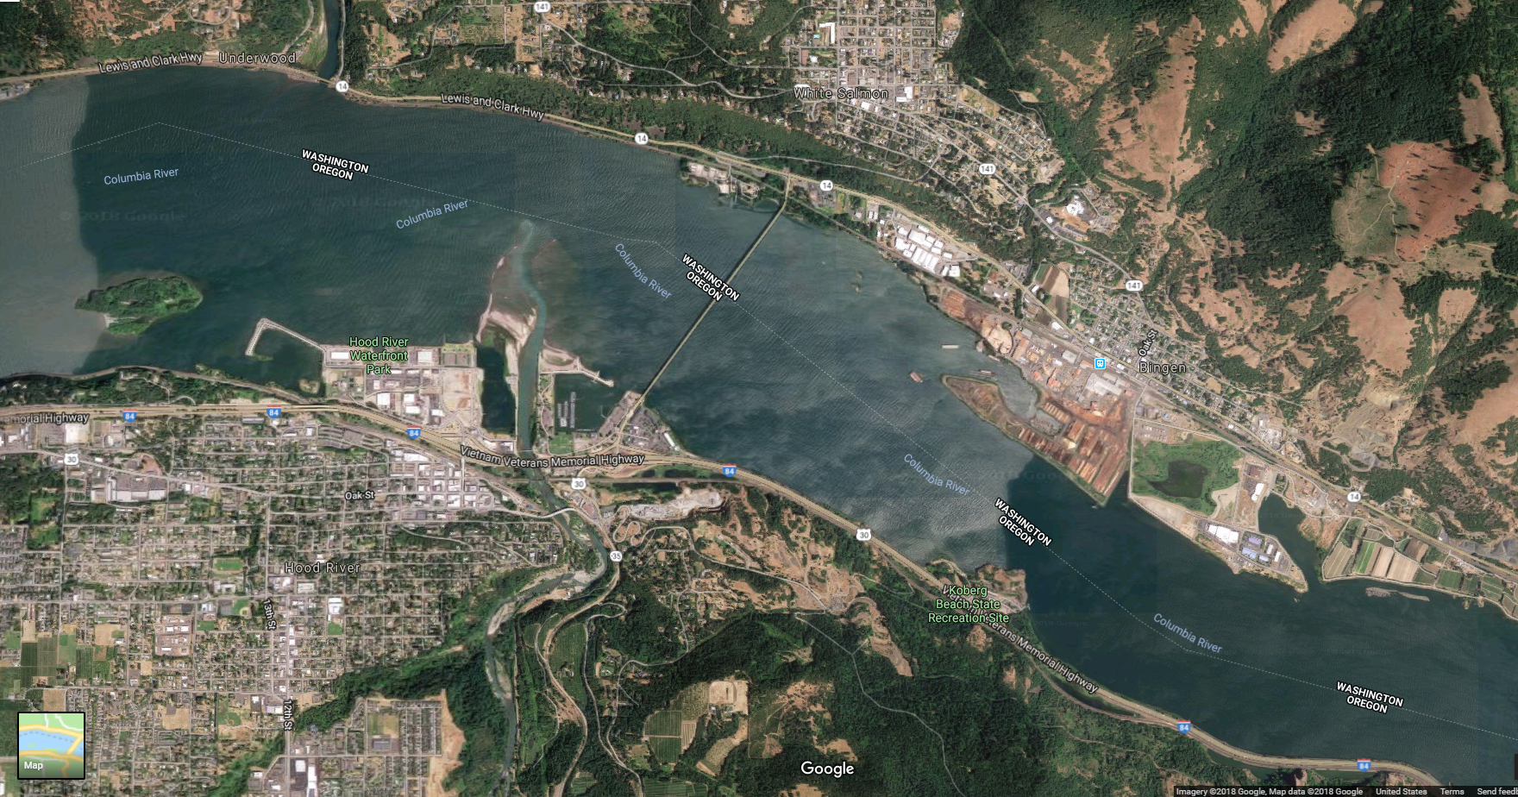
Hood River Bridge

Slide 34
Traffic Modeling Approach
No travel demand model
Built a spreadsheet-based model
Developed balanced network based on AADT counts
Considered two competing bridges – Bridge of the Gods to the west and The Dalles Bridge to the east

Slide 35
Route Choice Parameters for Each Bridge

Slide 36
Toll Diversion Curve

Slide 37
T&R Scenarios
Scenario 1
Existing bridge structure
No toll-rate modification
Scenario 2
New bridge opens in FY2029
Scenario 3
New bridge opens in FY2029
All Electronic Tolling (AET) begins in FY2029
Scenario 4
Toll collection continues by cash and BreezeBy
No toll-rate modification
Toll collection continues by cash and BreezeBy
Image-based toll rate equal to cash rate
No toll-rate modifications
New bridge opens in FY2029
All Electronic Tolling (AET) begins in FY2029
Image-based toll rate equal to cash rate
100% toll-increase is applied upon new bridge opening
Scenario 5
New bridge opens in FY2029
All Electronic Tolling (AET) begins in FY2029
Image-based toll rate equal to cash rate
100% toll-increase is applied upon new bridge opening
2% inflation per year beginning FY2030
Assumptions:
1. Auto-truck share remains unchanged over the forecast period.
2. Share of BreezeBy customers grows gradually
3. Annual traffic growth for first few years is based on historical trend; growth slows down over the forecast period

Slide 38
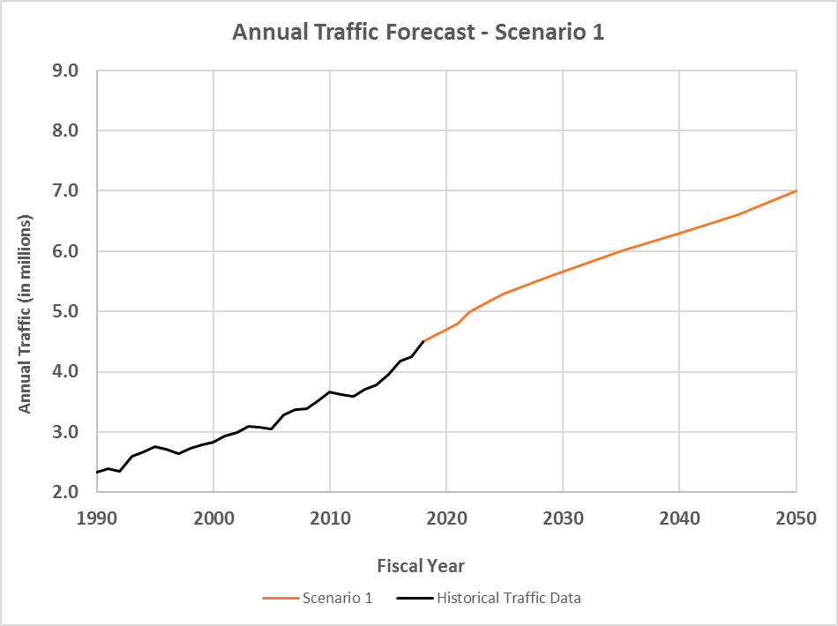
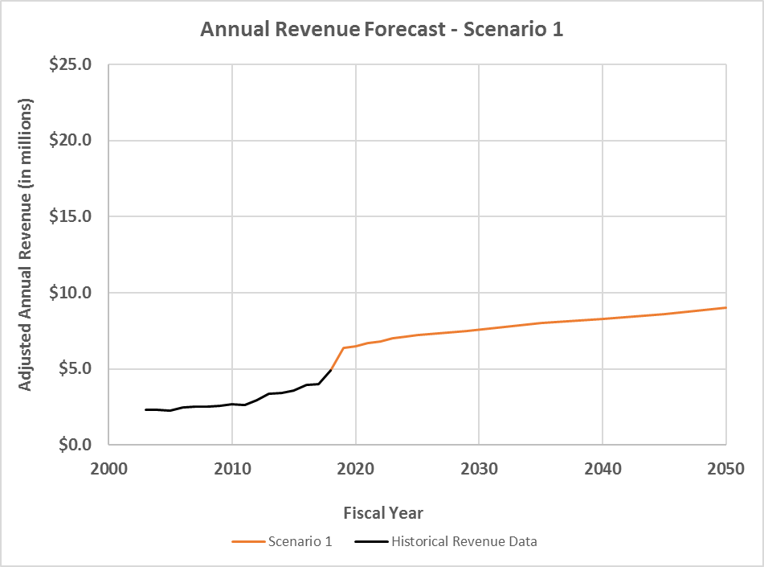
Scenario 1 – No-build Scenario

Slide 39
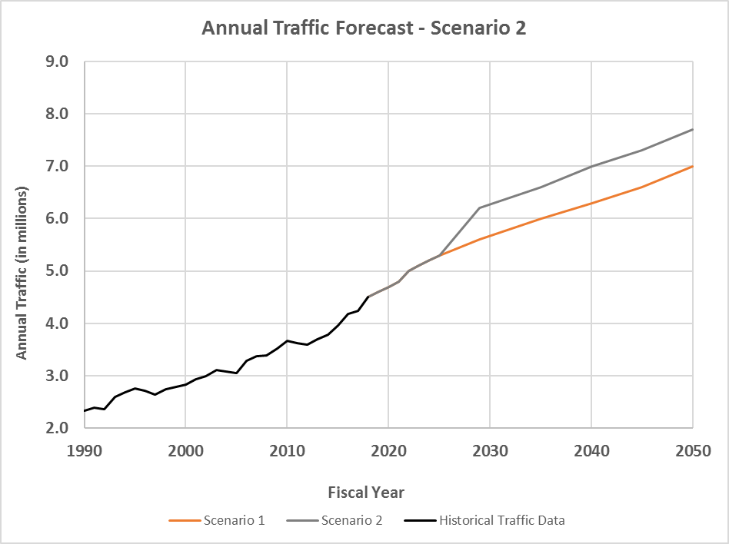
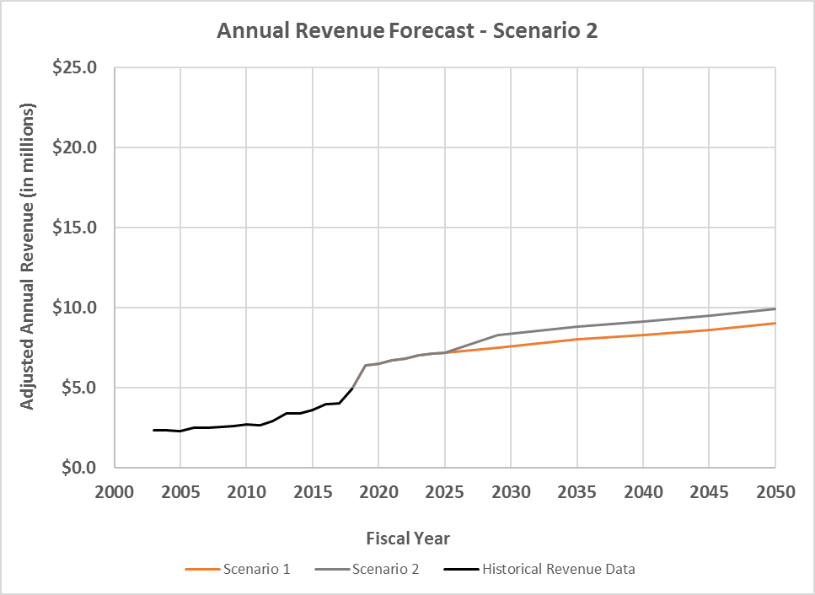
Scenario 2 – New Bridge Opens in FY2029

Slide 40
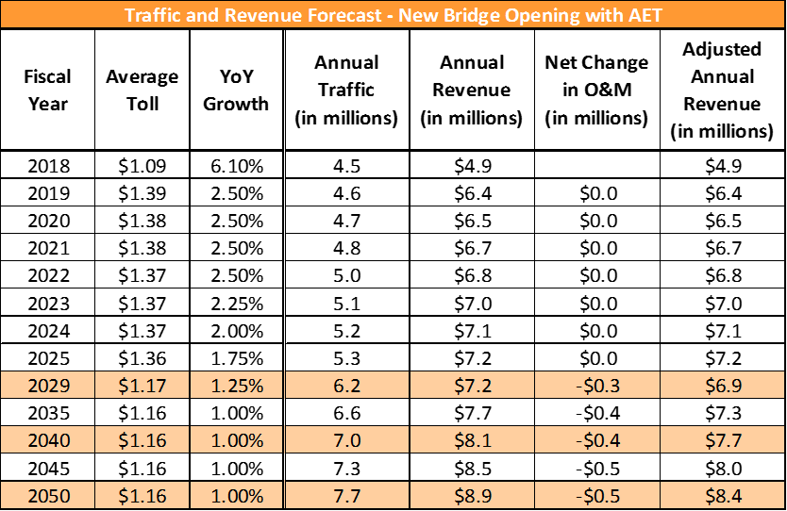

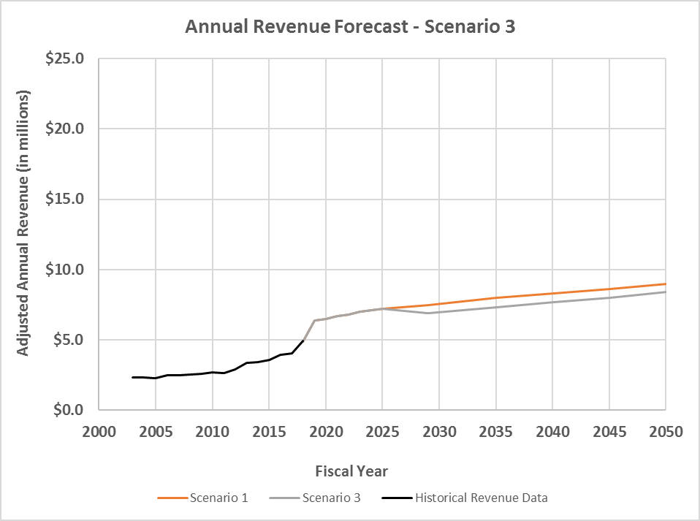
Scenario 3 – New Bridge Opens in FY2029 with AET

Slide 41
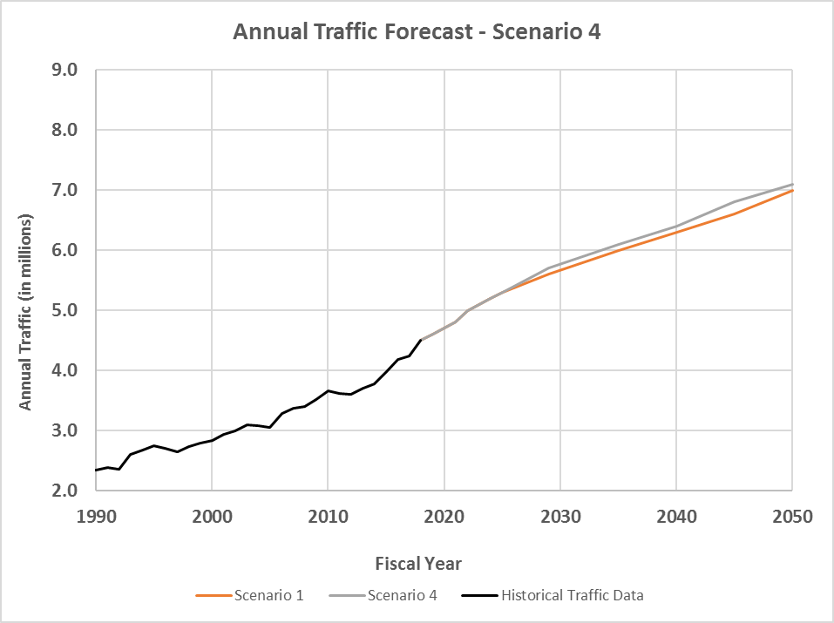
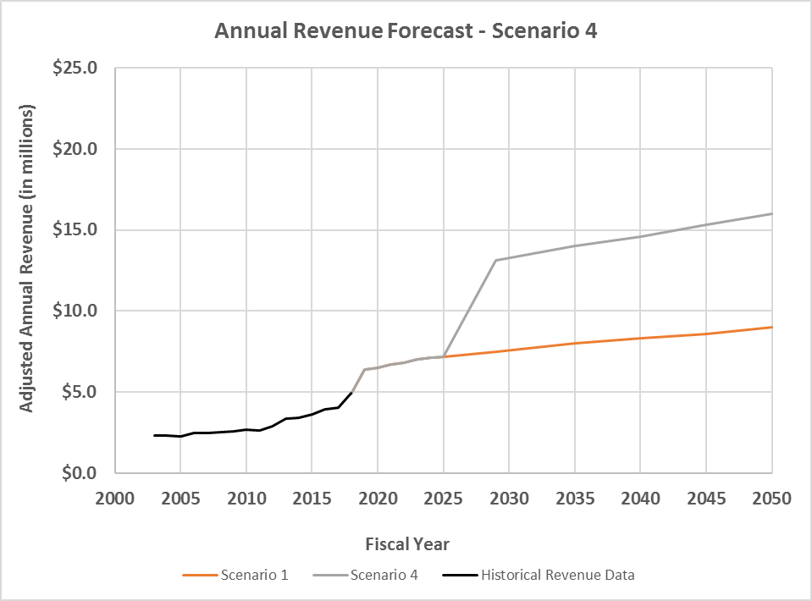
Scenario 4 – New Bridge Opens in FY2029 with AET & Toll Hike

Slide 42
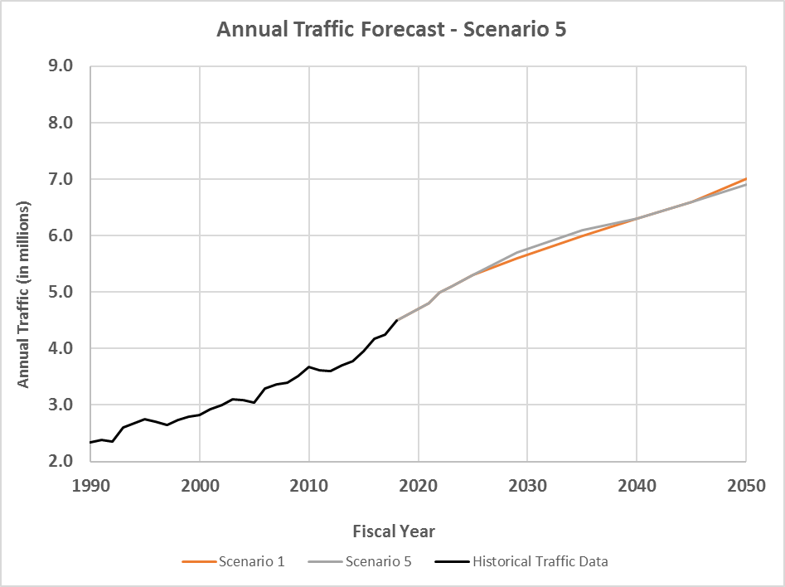
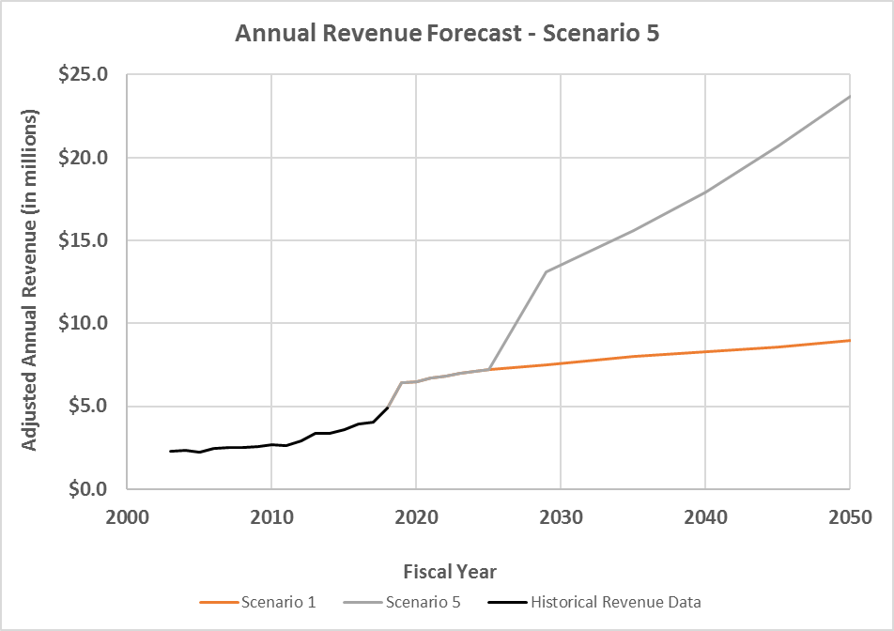
Scenario 5 – New Bridge Opens in FY2029-AET, Toll Hike & Inflation

Slide 43
Questions?

